Slide 1



ENERGY CONSUMPTION TREND ANALYSIS

Slide 2

Learning Objectives
Real-Time Dashboarding
Utility Consumption Tracking
Master DAX for Business Logic
Improve User Interactivity and UX Design
Implement Goal Tracking and Alert Systems
AI-Assisted Suggestions Panel
Integrate Environmental Factors into Utility Analysis
Understand the Societal and Environmental Impact
GOAL
Source :
www.freepik.com/

Slide 3
Tools and Technology used
TOOLS:
Power BI Desktop & Power BI Service
Microsoft Excel (backend data source )
OpenWeather API (Real-time weather data )
DAX (Data Analysis Expressions)
TECHNOLOGIES:
Data Modeling (Star Schema)
Dynamic UX Features(manual slicer & auto-rotate)
Goal Tracking & KPI Logic
Alerts & Highlight Automation

Slide 4
Methodology
Planning & Requirement Gathering
Data Sourcing & Integration
Data Modelling & Transformation
Logic & Metrics with DAX
Integration with OpenWeather
Visual Design & Dashboard Build
Visual Design & UI/UX
Testing & Validation

Slide 5
Problem Statement:
Lack of centralized, data-driven visibility into multi-building energy and resource usage results in operational inefficiencies, cost overruns, and resource wastage. Currently, building managers and urban planners struggle with inefficient usage of electricity, water, and gas due to fragmented data and lack of actionable insights. Hence this Power BI dashboard project addresses these critical need for real-time, data-driven visibility into energy and utility consumption across multiple buildings, that enables data-based decision-making, anomaly detection, and performance benchmarking — ultimately reducing costs, increases operational costs, resource waste, and missed sustainability targets and promotes sustainability.

Slide 6
Solution:
Using Microsoft Power BI, we developed a comprehensive dashboard solution that integrates usage data, rate structures, weather influence, and building metadata. The dashboard enables interactive monitoring, performance comparisons, anomaly detection, and cost simulations. It empowers users to make strategic decisions by visualizing trends and creating DAX measures, identifying inefficiencies, and forecasting the impact of utility rate changes. By centralizing utility performance insights, this solution not only helps reduce costs but also supports environmental sustainability, efficient resource allocation, and smarter facility management at scale.

Slide 7
Continue..
The Microsoft Power BI consists four Dashboards:
Dashboard1: This was developed in the aim of overview insights for know the actual Resources(Electricity, water, gas) usage vs expected usage with weak analysis for targeted, current and previous consumption by a consumer buildings integrated with rank top performance of a leaderboard.
Dashboard2: To know the individual throughput and deep insights, utility and functionalities this dashboard creates a comprehensible two graphs showcasing energy consumption and weather analysis of individual and city respectively.
Dashboard3: Further this dashboard breaks down a building’s energy use in five main systems: HVAC (climate control), Lighting (electrical lights), Equipment (machines and devices), Water Heating (heating water), and Renewable Sources (like solar energy) to explore how energy is used over time, by building, or by location—making it easier to understand usage patterns and find ways to save energy.
Dashboard4: Here I want to create hands-on helpdesk with Q&A bar in integration of Pro-tips section for core encouraging awareness over environment sustainability.

Slide 8
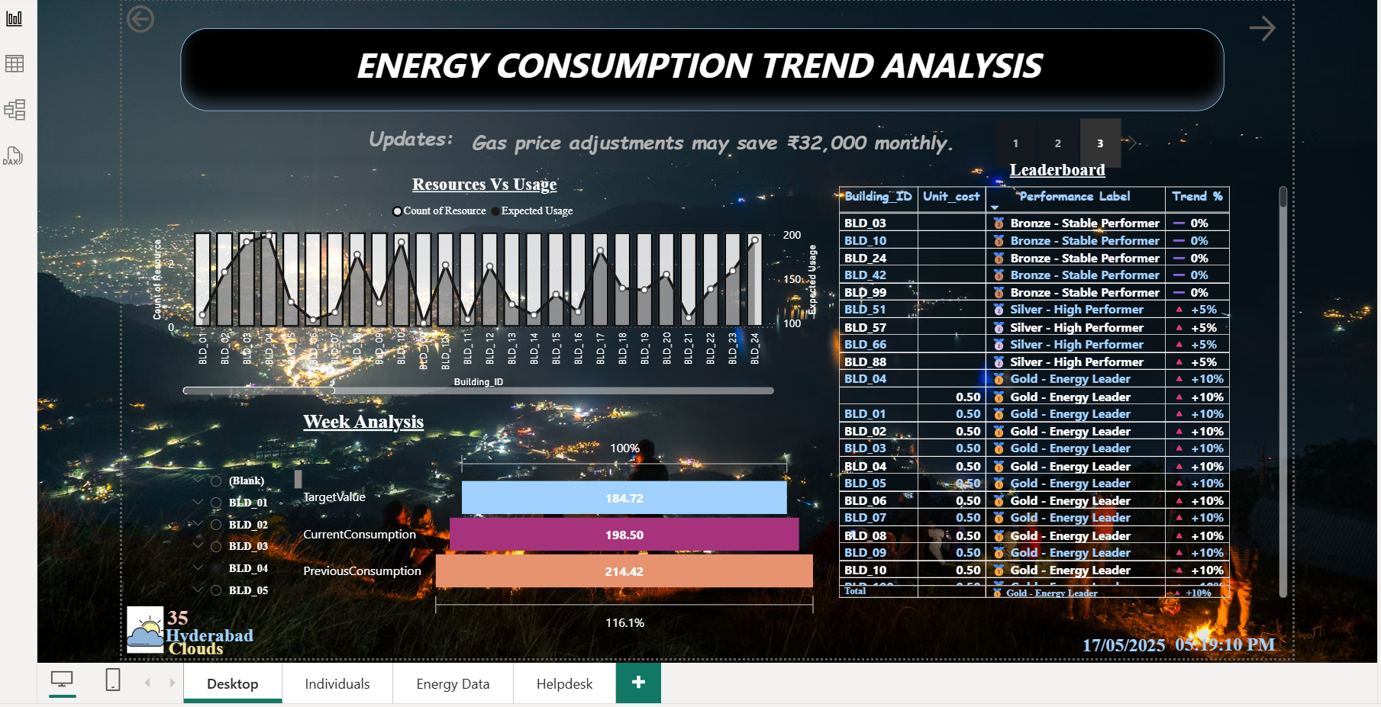
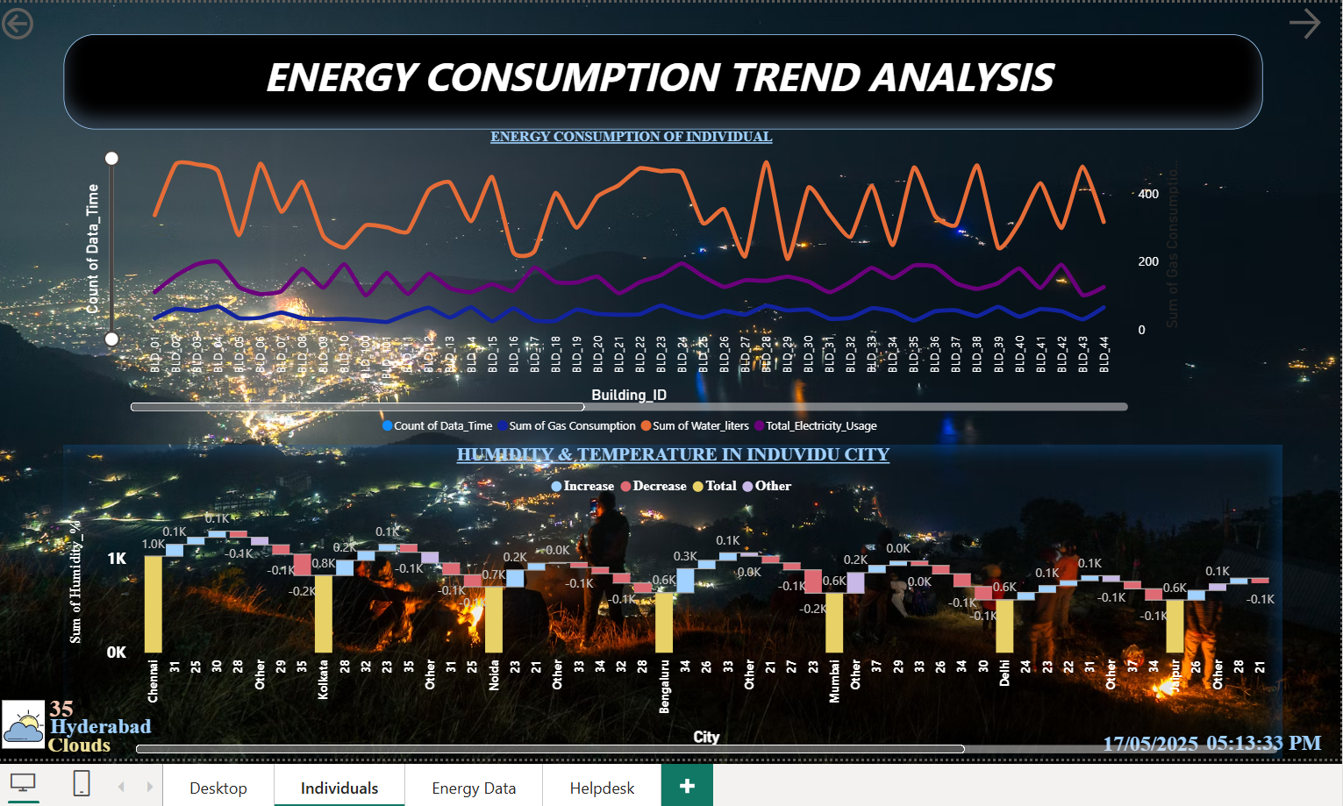
Screenshot of Output:

Slide 9
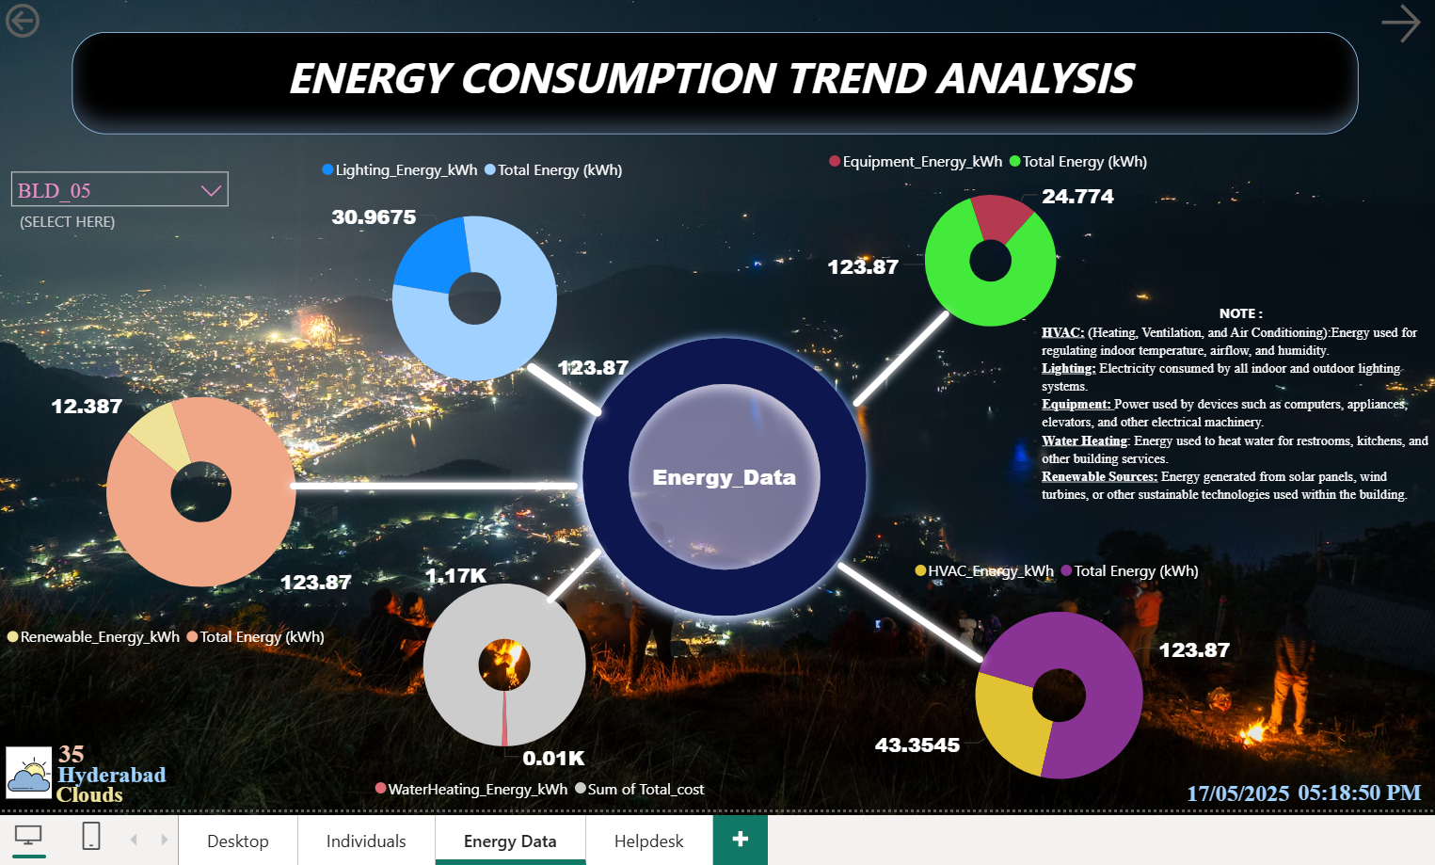
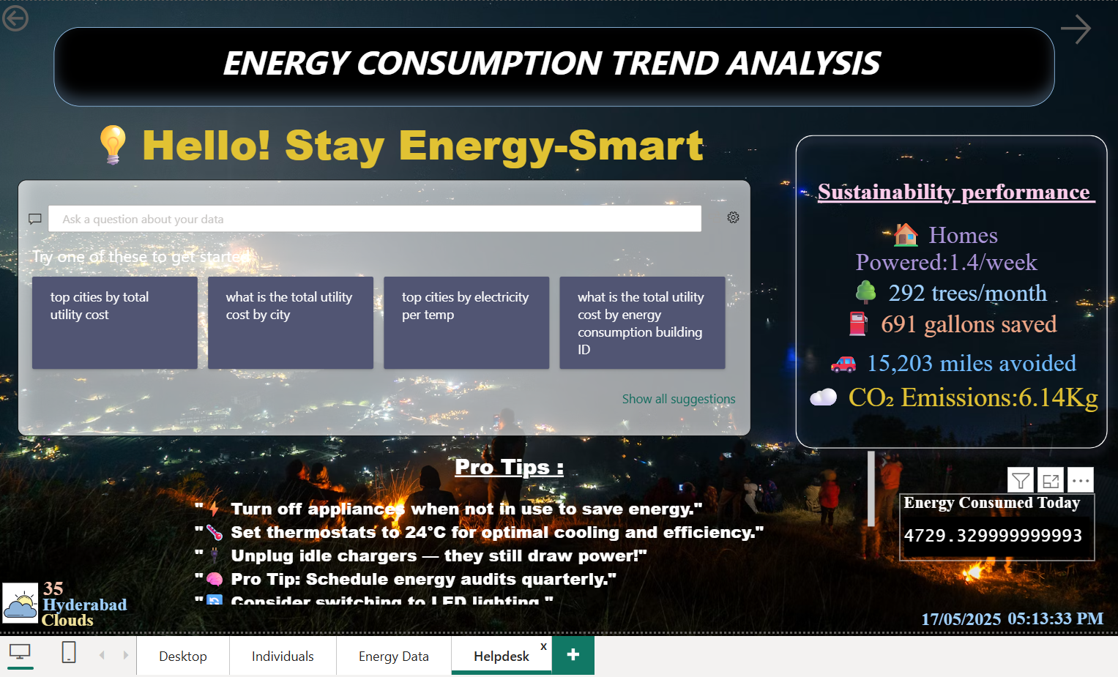

Slide 10
Conclusion:
With real-time, interactive insights into electricity, gas, water usage, and weather conditions, this Power BI dashboard equips facility managers and city stakeholders to act smarter and faster. Key features such as the leaderboard, goal tracking box, alert board, and graph visuals help users identify top-performing buildings, track progress toward consumption goals, and detect any anomalies in utility usage. The inclusion of environmental data also adds a valuable layer of context, highlighting how external factors impact consumption. This not only helps reduce utility waste and optimize costs but also strengthens sustainability efforts and supports smart city development. Designed for building operations, public sector infrastructure, and environmental planning, the solution bridges data and action—turning raw consumption metrics into meaningful, green decisions that benefit both organizations and society at large.

